Slide 1
ELECTRONIC CONFIGURATION, PERIODICITY
AND
BUILDING UP OF PERIODIC TABLE continuation

Slide 2
Recap
Oxidation number is usually an integer which can be plus or minus.
If decimal oxidation number is obtained ( such as for Fe in Fe₃O₄ or C in C₃H₈), then the oxidation number is an average oxidation number of the atom, and the atom have more than single oxidation numbers.
Example
To find the oxidation state of Fe in Fe₃O₄
The actual formula is FeO.Fe₂O₃
(combination of 2 compounds – FeO and Fe₂O₃)
In FeO, Fe has oxidation number of +2
And in Fe₂O₃, Fe has oxidation number of +3
NOTE
Three oxygen compounds of iron are known: ferrous oxide, FeO; ferric oxide, Fe₂O₃; and ferrosoferric oxide, or ferroferric oxide, Fe₃O₄, which contains iron in both +2 and +3 oxidation states

Slide 3

Electronic diagram and Configuration
Carbon has 6 electrons and can be represented thus:
Electronic Configuration: 1s²2s²2p²
1s 2s 2p OR 1s 2s 2p_{x} 2p_{y} 2p_{z}
The shorthand form of representing the arrangement of electrons in orbitals can be in form of a diagram or in a specified configuration as is shown for carbon above.
Another way of writing electronic configuration is to use the Abbreviated format. This involves using the configuration of noble gas preceding the desired element and filling the remaining valence electrons in the next principal quantum level.
Electronic Diagram:

Slide 4
Electronic diagram and Configuration
For example,
Sodium has 11 electrons: 2,8,1 or 1s²2s²2p⁶3s¹.
The nearest noble gas before sodium is Neon with electronic configuration: 1s²2s²2p⁶ which is one electron short of sodium configuration.
Hence sodium configuration can be written as:
[Ne]3s¹ which is the condensed or abbreviated format of sodium configuration.

Slide 5
Classification of orbitals of a many electron atom according to their energies.
Orbitals with same value of n and different value of l comprise a shell.
Example: 2s and 2p comprise a shell.
A group of orbitals with exactly equal energies comprise a subshell.
Example: 2p_{x}, 2p_{y} and 2p_{z}
Question: What accounts for the different energies observed by various subshells of same shell?
The orbital approximation ignores electron-electron repulsion, but takes into account Hund’s rule: electrons with parallel spins (↑↑) tend to stay apart compared to electrons with antiparallel spins (↑↓).
Answer: The reason behind different energies between the various subshells of the same shell is that there exists a mutual repulsion among the electrons in multi-electron atoms. The stability of multi-electron atom is due to the bigger magnitude of attractive force between nucleus and electrons as compared to the forces of repulsion between electrons of the inner shell and outer shell. This is known as the shielding of the outer shell electrons from the nucleus by the inner shell electrons

Slide 6
Shielding effect or screening effect: Due to the presence of electrons in the inner shells, the electron in the outer shell will not experience the full positive charge on the nucleus.
So, due to the screening effect, the net positive charge experienced by the electron from the nucleus is lowered and is known as effective nuclear charge. Effective nuclear charge experienced by the orbital decreases with increase of azimuthal quantum number (l).
Question 1 The orbital with maximum energy is (a) 3d (b) 5p (c) 4s (d) 6d Solution As per n+l rule Question 2 Energy of atomic orbitals in a particular shell is in the order (a) s<p<d<f (b) s>p>d>f (c) p<d<f<s (d) f>d>s>p Solution As per n+l rule
Question 3 The energy of an electron of 2py orbital is (a) Greater than that of 2p_{x} orbital (b) Less than that of 2p_{x} orbital (c) Equal to that of 2s orbital (d) Same as that of 2p_{z} orbital Solution
Question 4 Which elements belong to the same period? Q -1s²2s²2p¹;
R - 1s²2s²2p⁶3s²;
S - 1s²2s²2p⁶3s²3p¹;
T - 1s²2s²2p⁶
U - 1s²2s²2p⁶3s²3p⁵.
Solution
D
D
A
Q & T. and S & U.

Slide 7
Effective nuclear charge (Zeff)
Effective nuclear charge (Zeff) on the outer electrons maintain hydrogen-like orbitals as an approximation, but subshell energies are not equal: E_{ns} < E_{np} < E_{nd} < E_{nf}
Subshell energies: E_{3s} < E_{3p} < E_{3d}
Effective nuclear charge (Z_{eff}) is the net positive charge experienced by valence electrons. The magnitude of the shielding effect is difficult to calculate precisely. As an approximation, we can estimate the effective nuclear charge on each electron. It can be approximated by the equation: Z_{eff} = Z – S, where Z is the atomic number and S is the number of shielding electrons.
An s electron penetrates to the nucleus more than a p electron: a p electron penetrates to the nucleus more than a d electron: more penetration, more stability, lower energy.

Slide 8
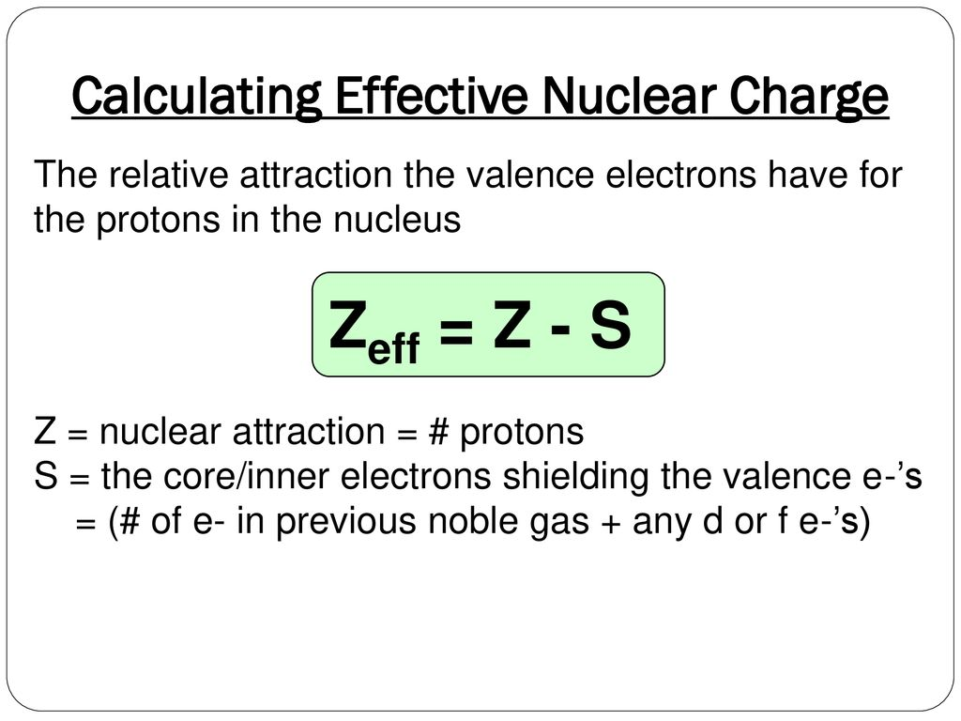
Effective nuclear charge

Slide 9
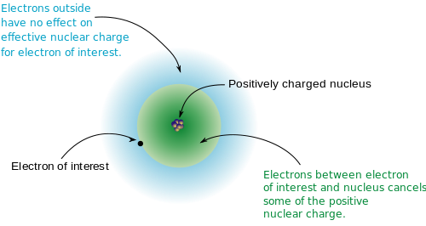
Effective nuclear charge
The effective nuclear charge (often symbolized as Z_{eff} or Z*) is the net positive charge experienced by an electron in a multi-electron atom.
The term “effective” is used because the shielding effect of negatively charged electrons prevents higher orbital electrons from experiencing the full nuclear charge.

Slide 10
Effective nuclear charge
Example
Consider a neutral neon atom (Ne), a sodium cation (Na⁺), and a fluorine anion (F–). What is the effective nuclear charge for each?
Start by figuring out the number of nonvalence electrons (which can be determined from the electron configuration).
For Neon
Ne has 10 electrons.
The electron configuration is 1s²2s² 2p⁶.
The valence shell is shell 2 and contains 8 valence electrons.
Thus the number of nonvalence electrons = 2 (i.e. 10 total electrons – 8 valence). The atomic number for neon is 10,
Recall: Z_{eff} = Z – S, where Z is the atomic number and S is the number of shielding electrons
Therefore: Z_{eff}(Ne) = 10 – 2 = 8+

Slide 11
Effective nuclear charge (Z_{eff}) on the outer electrons
For Flourine ion
Flourine has 9 electrons but F– has gained an electron and thus has 10.
The electron configuration is the same as for neon and the number of nonvalence electrons is 2.
The atomic number for F– is 9,
Therefore: Z_{eff}(F–) = 9 – 2 = 7+
For Sodium ion
Sodium has 11 electrons but the Na⁺ ion has lost an electron and thus has 10.
Once again, the electron configuration is the same as in the previous example and the number of nonvalence electrons is 2
(by losing one electron, the valence shell becomes the n=2 shell).
The atomic number for Na⁺ is 11
Therefore: Z_{eff}(Na⁺) = 11 – 2 = 9+
Note: The atomic number remains the same whether in the ionic or non ionic form.

Slide 12
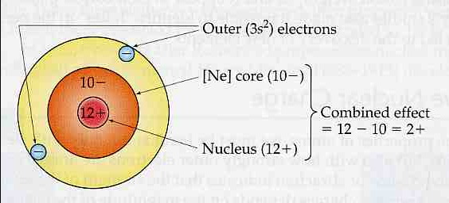
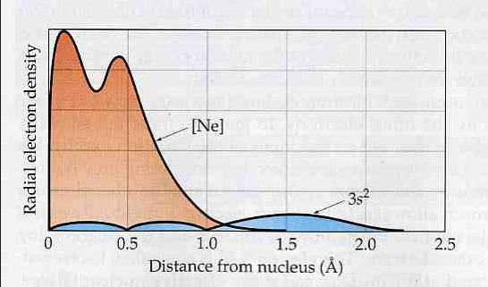
Effective nuclear charge (Zeff) on the outer electrons

Slide 13
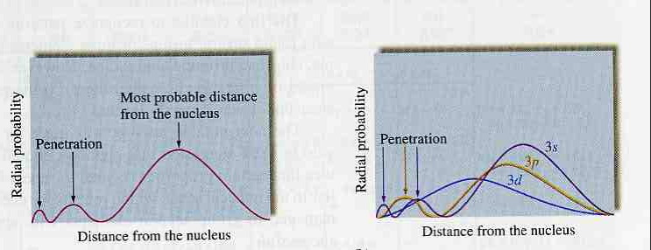
Electron shielding of the nuclear charge by other electrons & (n+l) rule
Why is the energy of a 3s orbital lower than than of a 3p orbital? Why is the energy of a 3p orbital lower than the energy of a 3d orbital?

Slide 14
The third full row of the periodic table: ¹⁹K-³⁶Kr
The 4s and 3d orbitals are close in energy in the one electron atom. Difficult to predict stability for multielectron atom.
The 4s orbital is slightly more stable than the 3d orbital at the beginning of the third full period of the periodic table:
¹⁹K = [Ar]4s¹3d⁰
²⁰Ca = [Ar]4s²3d⁰
The reason is that the 4s orbital has a higher probability of being closer to the nucleus and see a greater effective Z_{eff} than a 3d orbital.

Slide 15
Electron configuration of the transition elements: ²¹Sc through ³⁰Zn
²¹Sc, ²²Ti, ²³V, ²⁴Cr, ²⁵Mn, ²⁶Fe, ²⁷Co, ²⁸Ni, ²⁹Cu, ³⁰Zn
¹⁹K = [Ar]4s¹3d⁰
²⁰Ca = [Ar]4s²3d⁰
3s < 3p < 3d ~ 4s (may switch with Z)
NB: Energy levels are getting closer together for n = 3 as expected from the Bohr atom.
This means that factors ignored may have to be considered
What would you expect for ²¹Sc?
²¹Sc = [Ar]4s²3d¹.
Not quite correct….
The 3d electron is lower in energy than the 4s electron in ²¹Sc from experiment: ²¹Sc = [Ar] 3d¹4s²

Slide 16
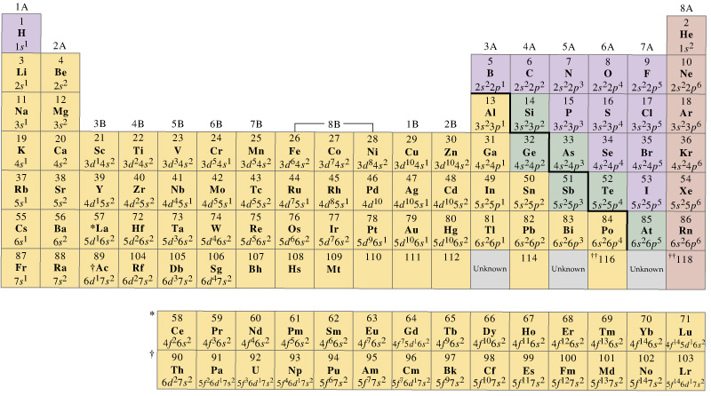
Periodic Table – Chemical trends
Periodicity is the recurrence of similar phenomena at regular interval.
Periodicity in chemical properties is the basis of the periodic table arrangement.
Periodicity of electron configuration:
Affects attraction of atom for its valence electrons
Affects attraction of valence electrons for additional electrons
Determines chemical and physical properties of the elements

Slide 17
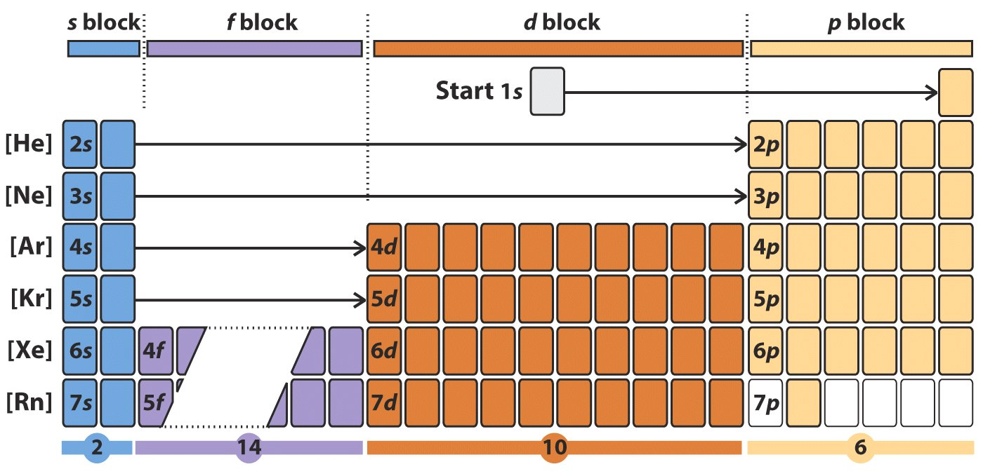
Modern Periodic Table

Slide 18
The periodic table and atomic properties
Electrons in the outermost shell of an atom are the most important in determining chemical properties. Chemical reactions involve only the outer (valence) electrons. The inner (core) electrons are not involved in chemical reactions.
Elements in a given vertical column (families) of the periodic table have similar outer-shell electron configurations and similar properties. They are isoelectronic with respect to the number of valence electrons.
Elements in a row show regular trends in their properties due to the continuing increase in the number of valence electrons until a shell is filled.
Electronegativity, Atomic size/Ionic size, Ionization Energy, Electron affinity,

Slide 19
Periodic Properties. Electronegativity.
Two critical properties determining chemical reactivity are the energies involved in adding or removing an electron from an atom.
Electronegativity is a measure of the power of an atom to attract electrons to itself.
Metals: Low tendency to attract electrons, high tendency to release electrons.
Non-metals: High tendency to attract electrons, low tendency to release electrons.

Slide 20
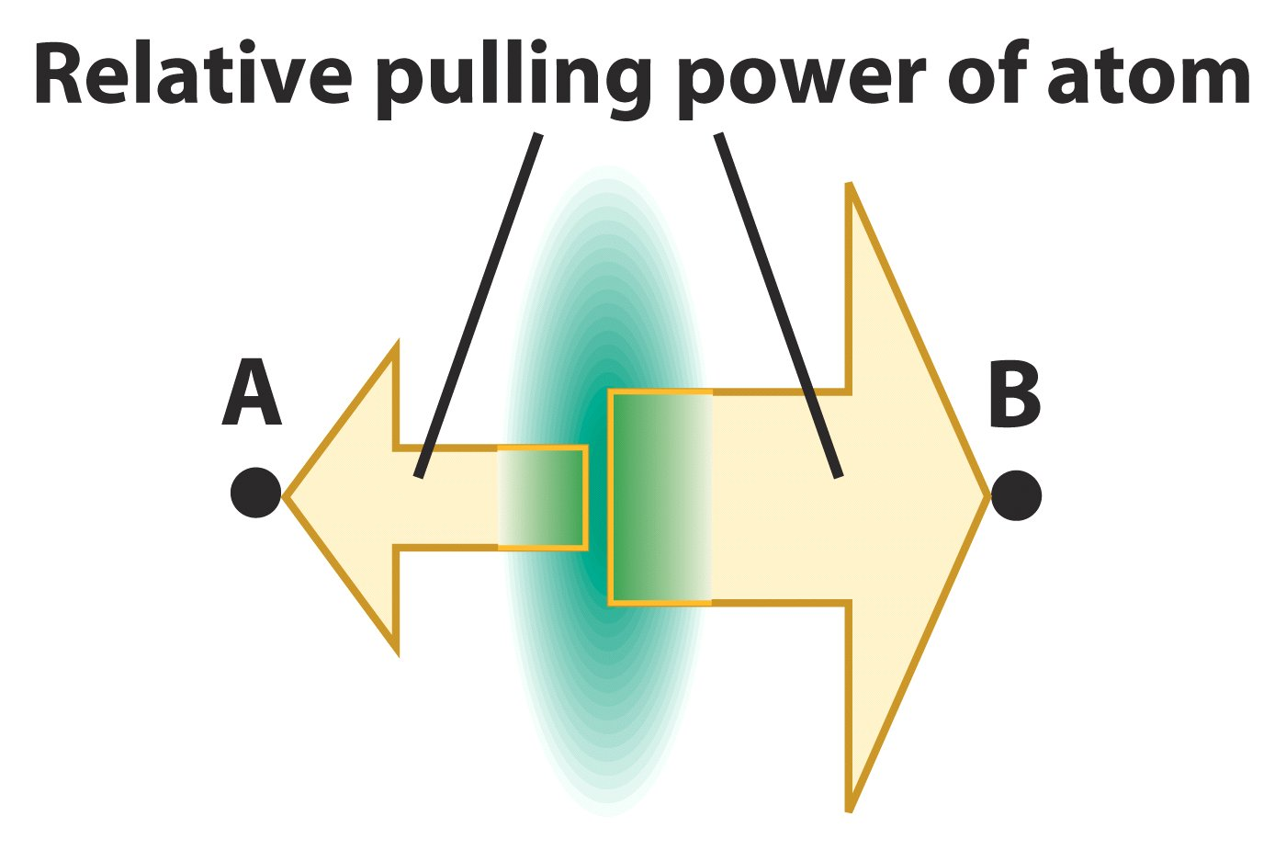
B has a bigger “pull” on the electrons in an A-B bond than A

Slide 21
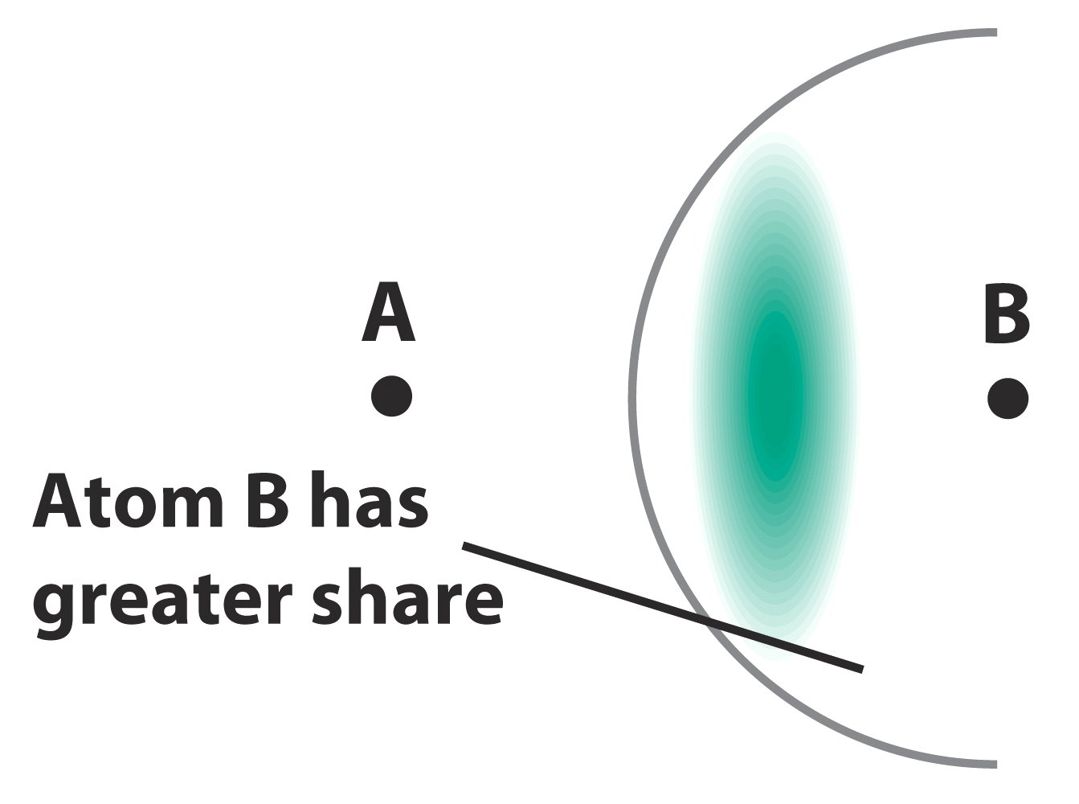
Electrons are closer to the more electronegative atom B.

Slide 22
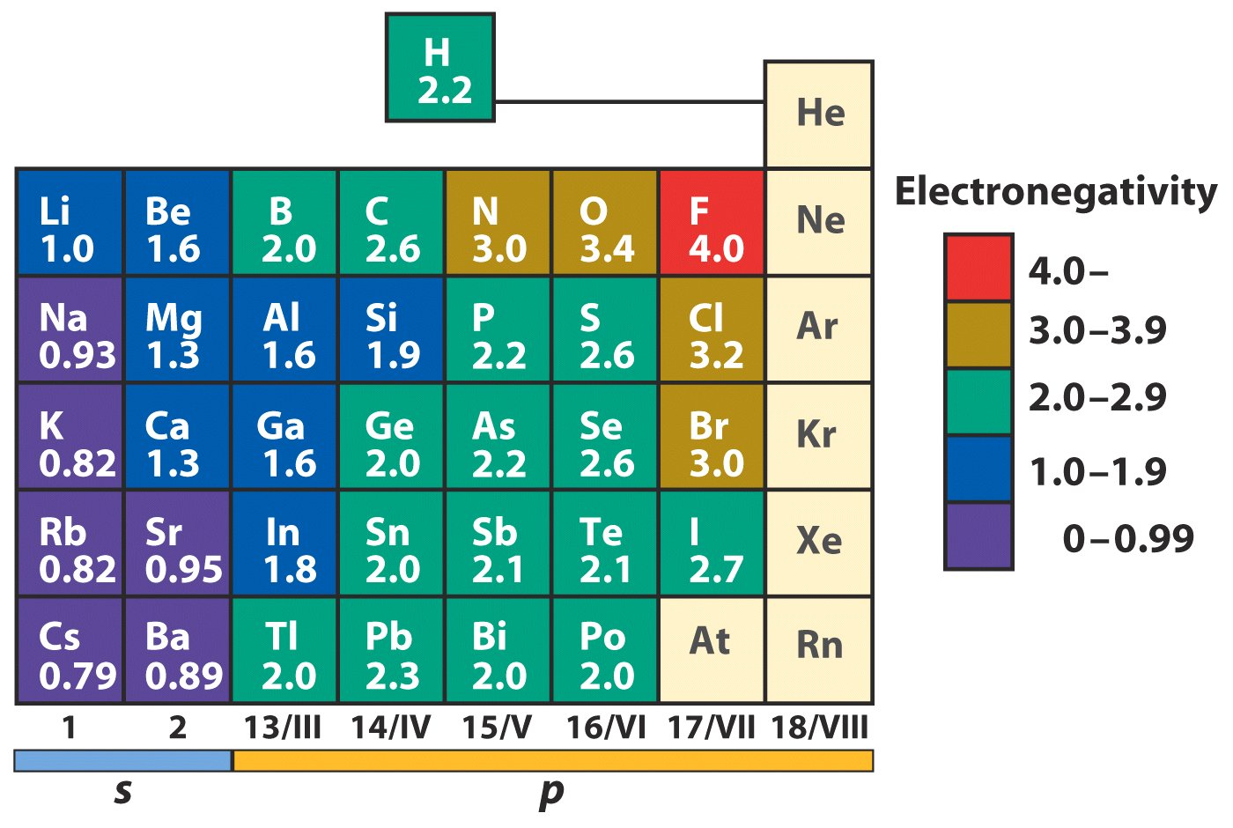
The periodic table by electronegativity

Slide 23
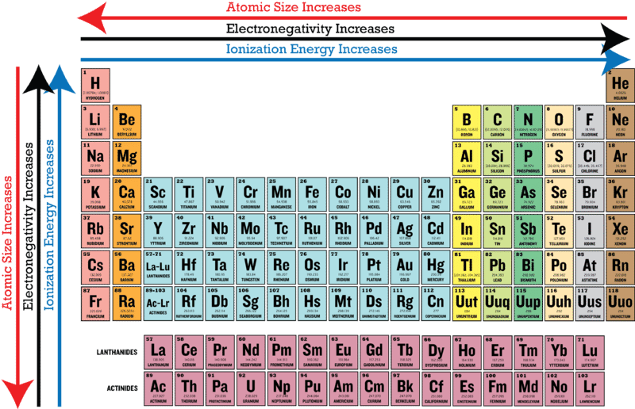
Periodic Table – Electronegativity
1.) Chemical trends based on the combination of the electron configuration, octet rule and electronegativity
2.) Electronegativity
a.) tendency to attract electrons in a compound
b.) empirically based range from 0.7 to 3.98

Slide 24
Periodic Table - Chemical Trends
5.) Electronegativity differences determine the outcome of a chemical reaction
Electronegativity of Chlorine is 3.16
Electronegativity of Bromine is 2.96
Halogen ions have an octet in valence shell
No need to share e⁻
clear
pale yellow
dark brown
clear
2Br⁻ has sixteen valence electrons (eight each)
Br₂ has only fourteen valence electrons
Two electrons lost from two Br⁻
Two electrons gained by Cl₂ to form 2Cl⁻
The greater electronegativity of chlorine captures an electron from bromide

Slide 25
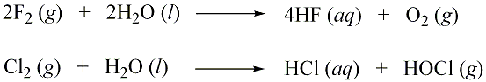
Periodic Table - Electronegativity
Example: electronegativity difference determines chemical products
Halides are expected to react similarly with water, but there are some important differences. Why?
Answer:
electronegativities: chlorine 3.16, oxygen 3.4, fluorine 3.98
fluorine can attract e⁻ from oxygen
- HF : eight valence electrons
- O₂ : six valence electrons
chlorine can not attract e⁻ from oxygen, instead attracts e- from
hydrogen in water and replaces hydrogen in water
- HCl : eight valence electrons
- HOCl : Cl replaces H in water

Slide 26
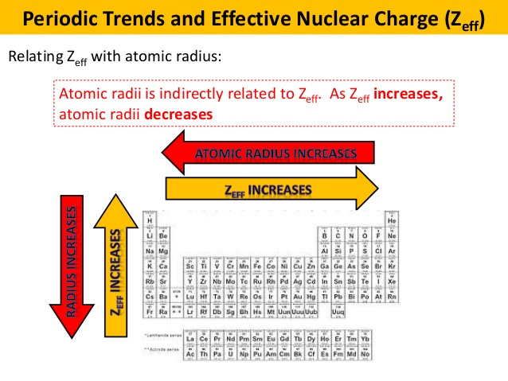
Sizes of Atoms and Ions - Periodic trends in Covalent radius, atomic radius and ionic radius
Radii generally increase down a group (n of outer shell increases) and decrease (as Z_{eff} increases for same shell) from left to right across a period.
Cations are generally smaller than their parent atoms whereas anions are larger than their parent atom.

Slide 27
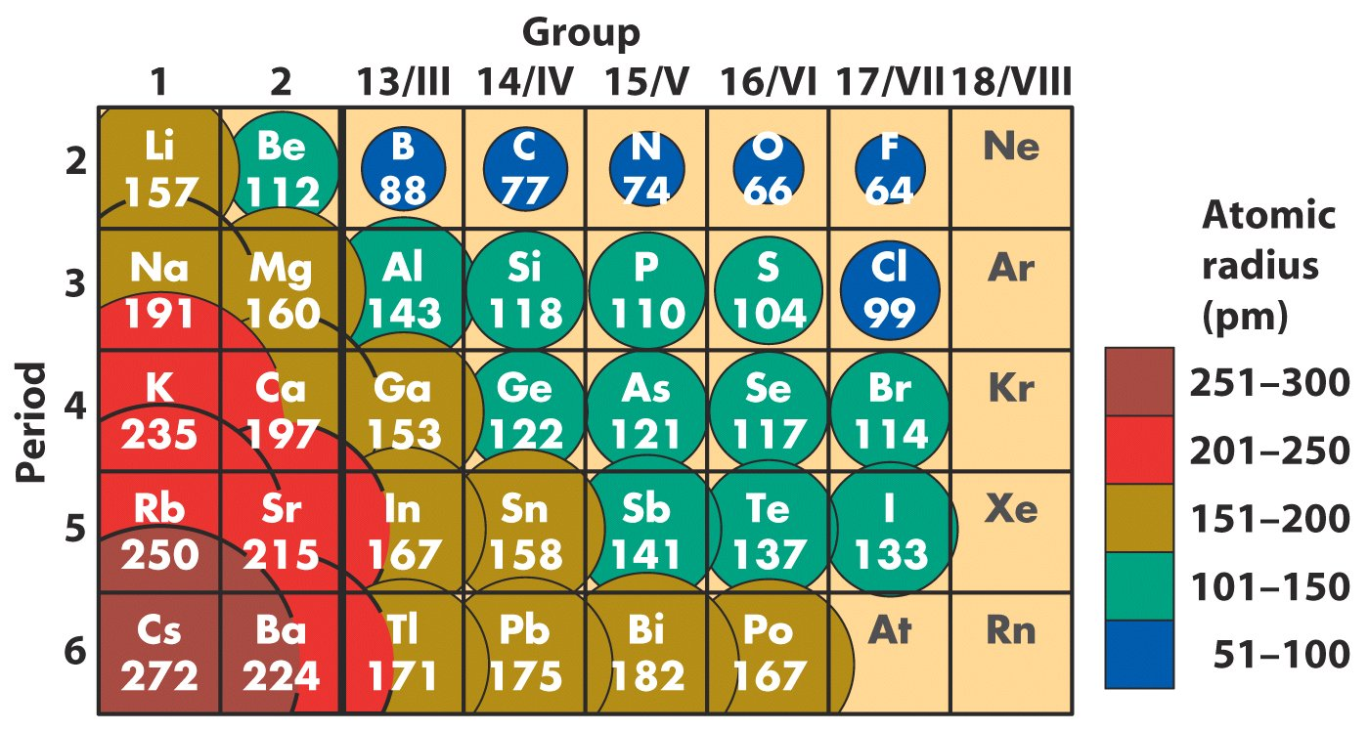
Periodic properties of atomic radius:
What are the correlations?
General Rule: The size of an atom decreases in a row as the nuclear charge increases and the size of an atom increases in a column as the nuclear charge increases

Slide 28
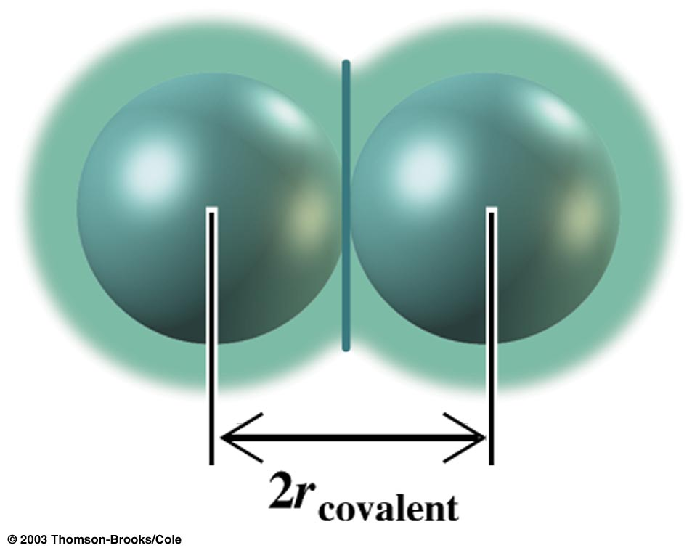
Covalent Radii from Experiment
The covalent radius is defined as half the distance between two atoms bound by a single bond in a molecule.

Slide 29
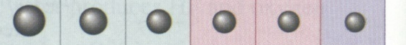
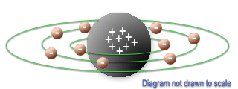
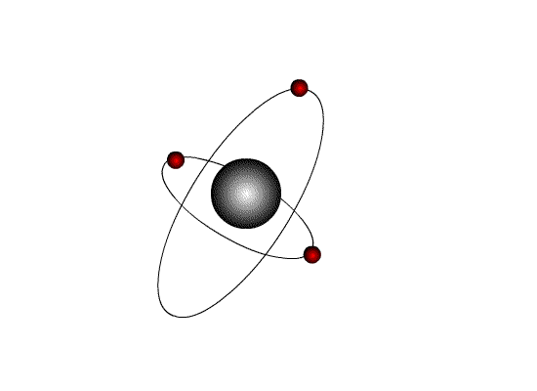
Periodic Table – Atomic size
Size of Atom
Changes in Size Affects Chemical Behavior
Increase in:
ionization energy
electron affinity
electronegativity
Increase in attraction
between nucleus and
electrons
Decrease in Radius

Slide 30
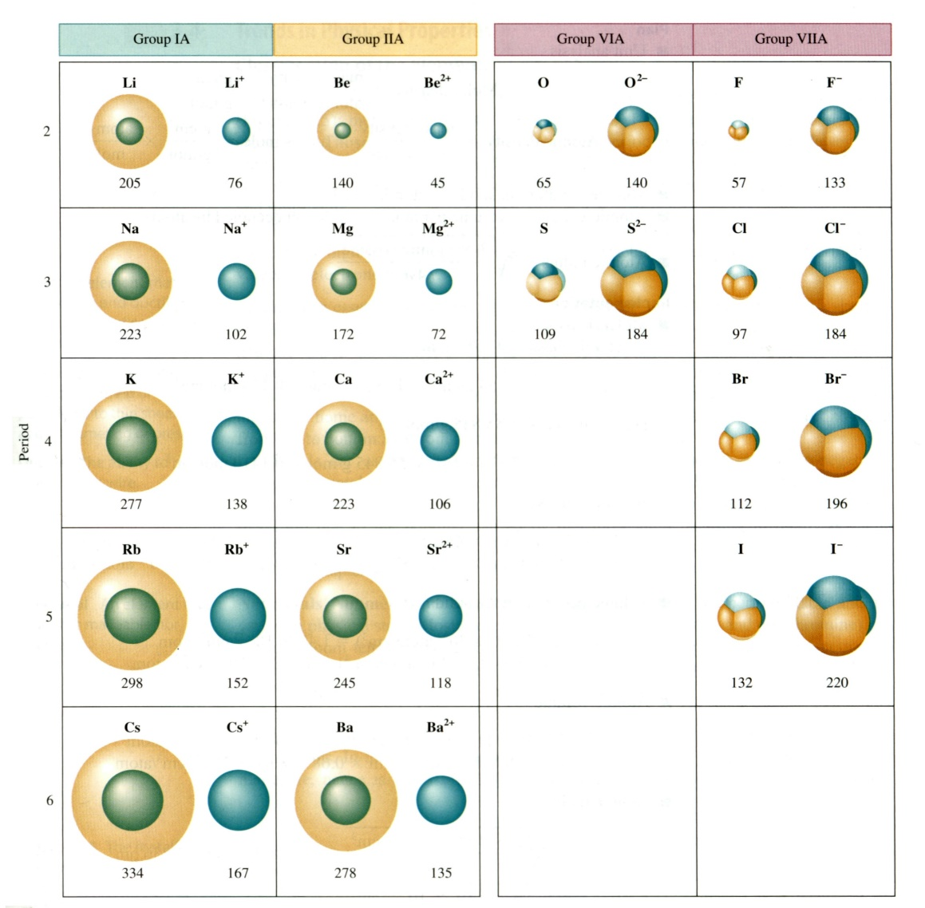
Periodic Table – Ionic size
Size of Ion
When an atom gains or loses an electron, the ion is a different size than the neutral atom
Like Charges Repel:
Remove e⁻ → remove repulsion → smaller
positive charged ion (cation) is smaller
Add e⁻ → add repulsion → larger
negatively charged ion (anion) is larger
Size difference can be dramatic, about a factor of 2

Slide 31
Ionization energies (ionization potentials):
The ionization energy (IE) of an atom is the minimum energy required to remove an electron from a gaseous atom.
X(g) X⁺(g) + e⁻
The first ionization energy IE₁ is the energy required to remove the first electron from the atom, the second ionization energy IE₂, is the energy required to remove the second electron from the +1 positive ion of the atom and so on.
Conclusions from experimental IE values:
An abrupt change in IE in going along a row or column of the periodic table indicates a change in the valence electron shell or subshell.
Let’s take a look:

Slide 32
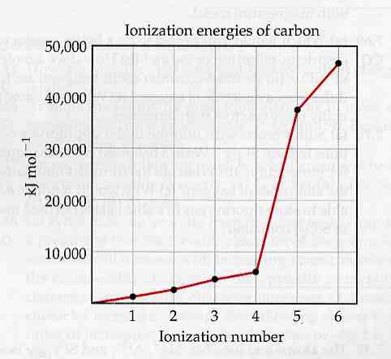
Experimental data and theoretical ideas
Explain the “two slopes” for the ionization energies of carbon.

Slide 33
It takes more and more energy to remove an electron from an increasingly positively charged atom.
The first smaller slope is due to removal of n = 2 electrons, the second larger slope is due to removal of n = 1 electrons.
⁶C⁺⁵ 1s¹2s⁰2p⁰
⁶C⁺⁴ 1s²2s⁰2p⁰
⁶C⁺³ 1s²2s¹2p⁰
⁶C⁺² 1s²2s²2p⁰
⁶C⁺¹ 1s²2s²2p¹
⁶C 1s²2s²2p²

Slide 34
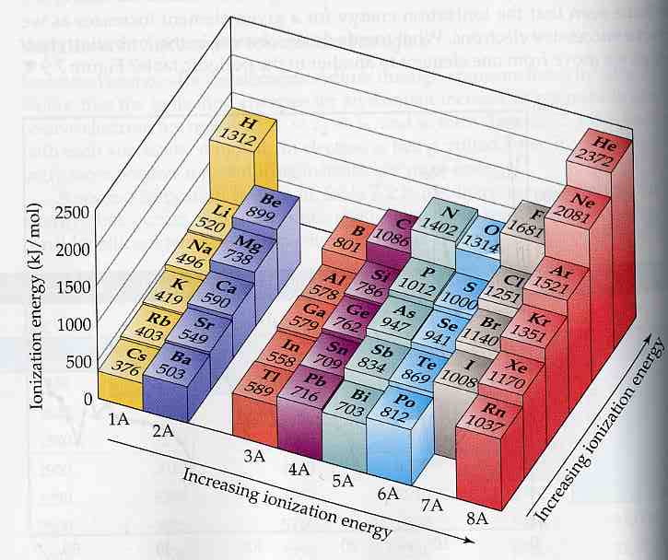
Periodic Table – Ionization energy

Slide 35
Factors affecting Ionization Energy
Distance of the Outermost Electron from the Nucleus: Across period, as Z increases, atomic radius decreases, attraction of positive nucleus for the electron increases; more energy is required to remove the outermost electron, thus IE increases.
The Size of the Positive Nuclear Charge: As the nuclear charge increases, its attraction for the outermost electron increases, and so more energy is required to remove the outermost electron. Hence, the IE increases.
Screening/Shielding Effect of the Inner Electrons: The outermost electrons are repelled by all the other electrons in the atom, besides being attracted by the positively charged nucleus. The electrons on the same shell also exerts a screening effect on one another but the effect is very small.
Across the period, there is a rise in ionization energy because the nuclear charge is increasing across period. This eventually causes a decrease in atomic radius. The screening effect remains almost the same across a period since electrons are added to the same shell. This accounts for the increase in IE across period.

Slide 36
What is a main factor that results in an atom having an increasing atomic radius compared to its neighbor?
a) total number of electrons
b) total number of protons and neutrons
c) total number of electrons in the outer electron shell
d) total number of electron shells
2. For each pair of atoms below, circle the atom with the larger radius:
a) Ga. b) Ga³⁺. c) Ca. d) Br
3. Which of the following elements would have the largest second ionization energy:
a) K. b)Rb. c) Sr. d) Ca.
Recall that the larger the effective nuclear charge, the more the electrons get attracted towards the nucleus.
Naturally, the larger-charged element has the greater effective nuclear charge.

Slide 37
Periodic Table – Electron Affinity
The Electron Affinity (EA) of an atom is the energy change (released) which occurs when an atom (gaseous) gains an electron to form a gaseous ion.
X(g) + e⁻ → Xe⁻ (g)
When the negative ion forms readily, a lot of energy is given off. i.e. Electron affinity has a large negative value. It increases with decrease atomic radii and decreases with increase atomic radii except for noble gases. This is because atoms with small atomic radii rend to have a stronger attraction for electrons and so forms negative ion more readily.
Why do Noble gases (NG) have Zero Electron Affinity?

Slide 38
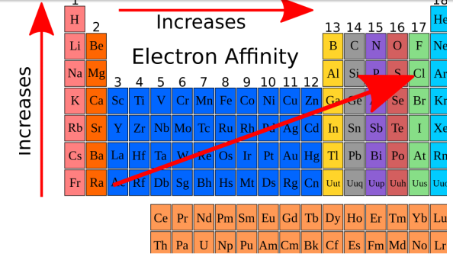
Periodic table – Electron Affinity
Noble Gases have stable electronic configuration and have no tendency to accept electrons.
NB: Electron affinity is rarely applied to second or third electron affinity levels because the elements are so unstable, and thus unable to survive long in nature. If they do exist the values for the electron affinities are all positive.

Slide 39
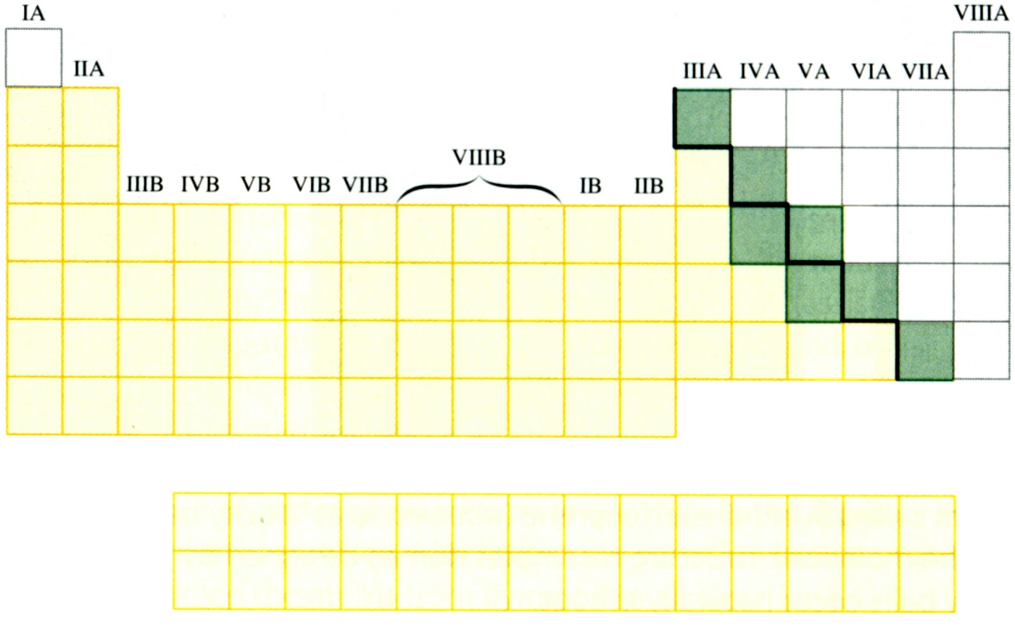
Periodic Table - Trends in Physical Properties
Classification of the Elements
Elements in Periodic table are classified into three broad categories
Nonmetals
Semimetals
Increasing metal characteristics
Metals
Metallic character associated with few valence s and p electrons and increases as those electrons are located farther from the nucleus

Slide 40

CHM 101 – PRACTICE QUESTIONS
Which of the following electron configurations indicates an atom with the highest ionization energy & why?
2,8,7. B. 2,8,8,1. C. 2,8,8,2. D. 2,8,8,7
What is the atomic & mass number of an element whose cation Y⁺ has the electronic configuration 1s²2s²2p⁶3s²3p⁶?
How many valence electrons are in a chloride ion CI⁻ & what orbital(s) do they occupy (include the n-value)?
What is the number of proton, neutron & electron in 45₂₁X? what is the sum of its proton and electron?
What is electron configuration of ₂₂X ²⁺ ion? Calculate the effective nuclear charge
Arrange the following elements in order of increasing electron affinity& explain: Br₂, CI₂, I₂, F₂
6. Which set belong to the same group, same period W: 1s²2s², X: 1s²2s²2p⁶, Y: 1s²2s²2p⁶3s², Z: 1s²2s²2p⁶3s²3p²?
7. What does elements in the same group have in common? What does elements in same period have in common
8. Which of the following statements is not true of halogens?
they exist in different physical states. B) they exist as diatomic molecules. C) their ionic radii decrease down the group. D) their melting and boiling points increase down the group.
9. In which of the following atoms is the ionic radius larger than the atomic radius & why so? [₁₁ Na, ₁₂Mg,₁₃AI,₁₇CI]
10. Which of the following properties of atoms generally increases down a group in the periodic table?
Electron affinity B) Electronegativity C) Ionic radius D) lonization energy
11. Is Na smaller in size than Na⁺? Give reasons for your answer
In question 12 above, which has the highest effective nuclear charge? Explain
Why is potassium atom very willing to form potassium ion?
A transition metal would be expected to A) from oxides with different formulae B) have strong oxidizing ability C) have low density D) have an atomic structure with an incomplete outermost shell
15. Sodium and potassium belong to the same group of the Periodic Table. This is because?
A. both are metals. B. both are soft and lighter than water. C. both form cations by losing electrons
D. both have identical electronic configuration. E. both react with water vigorously
16. The distance between the nuclei of chlorine atoms in a chlorine molecule is 0.194 mm. What is the atomic radius of chlorine atom? What property of chlorine makes hydrogenchloride more ionic than chlorine molecule?
17. Why does neon exist as single atoms but fluorine exists as molecules?
18. What is the difference between orbits and orbitals? Differentiate between ion and radical.
19. An electron with principal quantum no of 4 belongs to what shell? What’s the maximum no of electrons?

Slide 41
CHM 101 – PRACTICE QUESTIONS
20. What information does the azimuthal quantum no give? What are its possible values for an M-shell electron?
21. An electron with n-value of 3 and l-value of 2 belongs to what orbital?
22. The maximum number of orbital spatial orientations allowed for an f-orbital is? How much electron can it hold?
23. Write the values of n, l, m, & s for the 3 electrons of lithium?
24. Using chlorine as an example, explain the 4 quantum numbers, Aufbau, Hund’s & Pauli’s exclusion principle
25. Write the electronic configuration of the elements with 3, 9, 12, 17, & 20 protons. Name their groups, periods
26. For electrons on S, P, d, f orbitals, arrange them according to their penetration ability towards the nucleus.
27.Explain why chromium and copper prefers the electronic configuration of {Ar}3d⁵4s¹ & {Ar}3d¹⁰4s¹respectively
28. Which of these metals will not liberate hydrogen from dilute HCI?
A) Copper B) Iron C) Magnesium D) Zinc (Read displacement reaction!)
29. Which of the following equations represents a substitution reaction?
A) C ₂H_{10(g)} + CI _{2(g)} → C₄H₉ CI_{(g)} + HCI_{(g)} B) C ₂H_{4(g)} + HCI _{(g)} → C ₂H₅ CI_{(l)}
C) C₂H_{2(g)} + 2H _{2(g)} → C ₂H_{6(g)} D) C ₃H_{4(g)} + 40_{2(g)} → 3CO_{2(g)} + 2H ₂O_{(g)}
30. A transition metal would be expected to
A) from oxides with different formulae B) have strong oxidizing ability
C) have low density D) have an atomic structure with an incomplete outermost shell
H₂O₂ and SO₂ can both serve as oxidizing and reducing agent. Exemplify
Which of the hydrogen halide has the highest entropy HF, HCl, HBr, HI? Explain
The simplest unit of water that retains its property is called? A. Atom B. Hydroxide C. Molecule D. Element
What does chemical symbols represent? A) Chemical formulae B) Molecular formulae C) Structural formulae D) Atomic formulae. Calculate the Oxidation number of chlorine in HClO₄
35. If Z has a combining power of 3, write the chemical formula & atomicity of Z-oxide, Z-Carbonate & Z-sulphate
36. Write the type(s) & net ionic equation of 2NaOH(aq)+MgCl₂(aq)→2NaCl(aq)+Mg(OH)₂(s) and Fe(NO₃)₃(aq)+3NaOH(aq)→Fe(OH)₃(s) +3NaNO₃(aq). What are spectator ions?
37. Why is chlorine a gas, bromine a liquid, and iodine a solid at room temperature?
38. What type of organic reaction is esterification reaction classified under? What organic reaction is this reaction classified under C₂H₅COOCH₃+H₂O → C₂H₅COOH+CH₃OH
39. What type of reaction(s) are represented below (some belong to more than 1)? Fe₂O₃(s)+3CO(g)→2Fe(s)+ 3CO₂(g), Zn + CuSO₄(aq) → ZnSO₄(aq) + Cu(s), CdSO₄(aq)+K₂S(aq) → CdS(aq)+K₂SO₄(aq)

Slide 42
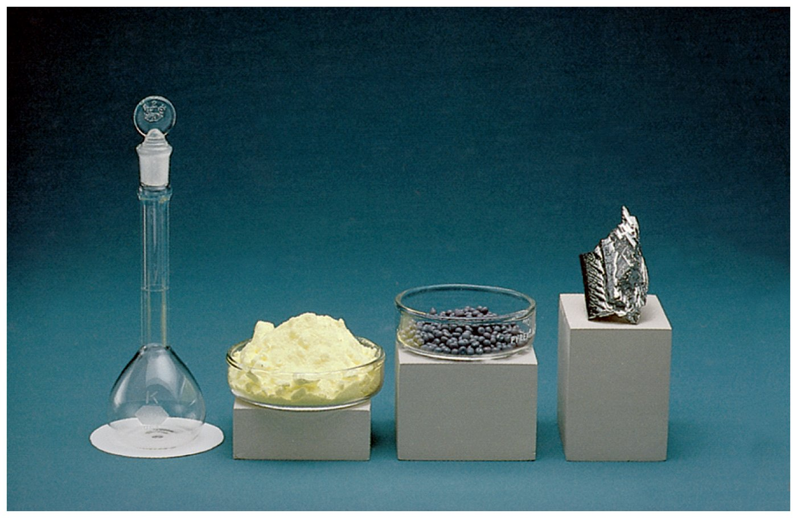
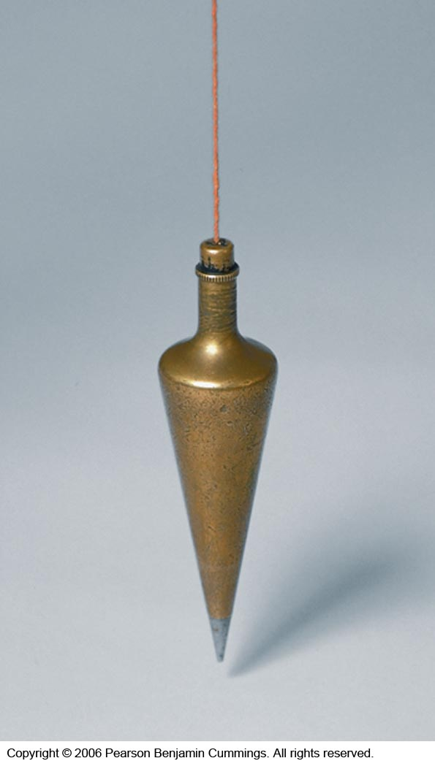
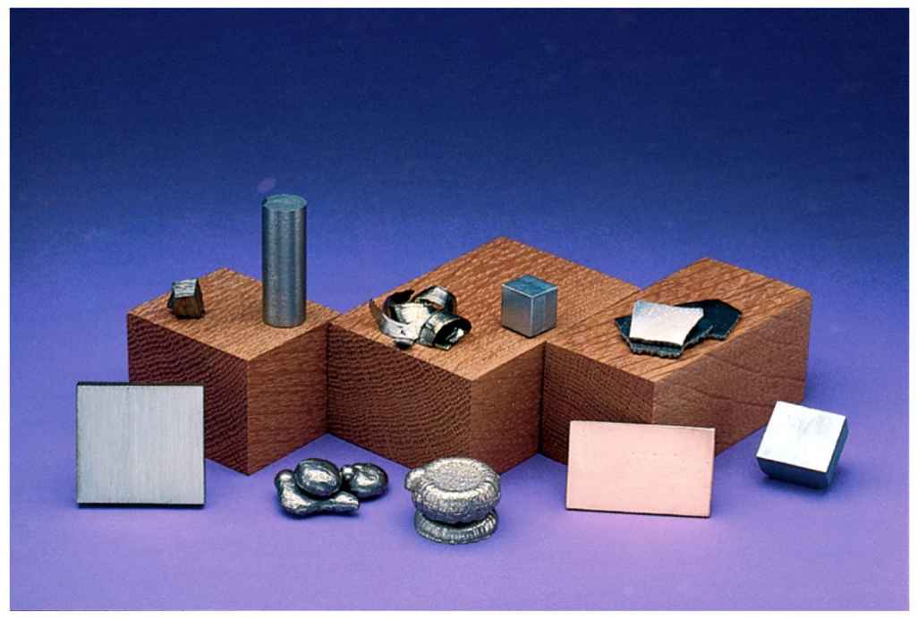
THANK
YOU
Notes:
A plumbob is heavy and used by carpenters to build walls straight. The word lead in latin is plumbum meaning heavy.

